Slide 1





STOCKMARKET FORECAST
Name : Dhatchina moorthi S
Guide: P.Raja
E.Mail: dhatchukutty011@gmail.com
Notes:
Slides: Prepare a short slide deck (10-12 slides) summarizing the project objectives, methodology, and key results.

Slide 2
OUTLINE
Abstract of the Project
Problem Statement
Proposed Solution
System Architecture
Live Demo of the Project
Embedded Video of Project
Conclusion
Future Scope

Slide 3
Abstract
Stock market forecasting plays a vital role in financial decision-making, empowering investors, organizations, and governments to manage risks and maximize returns. This study focuses on leveraging advanced machine learning (ML) techniques and computational models to predict stock price movements and trends. Traditional forecasting models often fail due to the volatile and non-linear nature of stock markets, influenced by various factors like economic events, investor sentiment, and global news. Our approach integrates historical stock data, technical indicators, and external datasets to build a predictive system capable of providing accurate forecasts. By employing methods such as Long Short-Term Memory (LSTM) networks and Natural Language Processing (NLP) for sentiment analysis, we aim to enhance predictive accuracy and reliability. The proposed system is designed to assist retail investors and institutional stakeholders in making informed decisions, reducing financial risks while capitalizing on market opportunities.

Slide 4
Problem Statement
Forecasting stock market movements is inherently complex due to the dynamic, volatile, and non-linear nature of financial markets. Existing traditional methods like statistical regression and econometric models often fail to capture complex patterns influenced by factors such as macroeconomic variables, geopolitical events, and investor sentiment. Moreover, the stock market’s sensitivity to real-time news and social media trends further complicates predictions. Investors face significant challenges in identifying accurate market signals and timing their trades, often leading to financial losses. This project addresses these challenges by developing an intelligent, data-driven forecasting system capable of handling high-dimensional datasets and incorporating diverse factors, including technical indicators, sentiment analysis, and external economic data. The goal is to enhance accuracy and reliability, thereby aiding investors in making better financial decisions.

Slide 5
Proposed Solution
The proposed solution leverages machine learning (ML) and deep learning (DL) techniques for stock market forecasting. Key components include: 1. Data Collection and Preprocessing: Aggregating historical stock prices, trading volumes, and external datasets such as economic indicators and news sentiment. Cleaning and normalizing data to improve model performance. 2. Feature Extraction: Identifying technical indicators (e.g., moving averages, RSI) and extracting relevant features from historical data and text sentiment. 3. Predictive Models: Utilizing LSTM networks for sequential data processing and NLP models for sentiment analysis of news and social media. 4. Integration: Combining outputs from different models to produce consolidated predictions. 5. Validation and Optimization: Using backtesting and cross-validation to evaluate model accuracy and fine-tune hyperparameters.

Slide 6
System Architecture
1. Data Input Layer: Sources include stock exchange APIs, financial news platforms, and social media feeds. 2. Data Processing Layer: Performs data cleaning, normalization, and feature extraction using statistical and computational tools. 3. Prediction Layer: Employs machine learning models such as LSTMs for time-series forecasting and NLP-based sentiment analysis models for textual data. 4. Integration Layer: Merges predictions from multiple models, applying weightage and ensemble techniques for final decision-making. 5. Visualization Layer: Outputs predictions via dashboards with graphical representations of trends, volatility, and suggested actions.

Slide 7
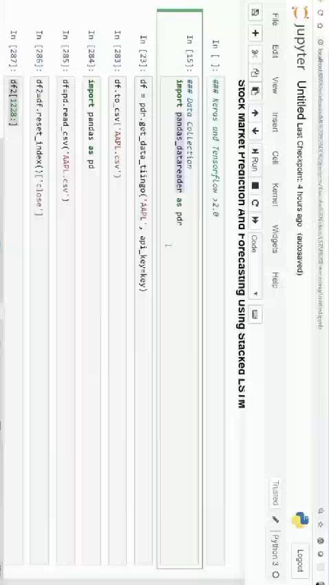
Video of Project Demo

Slide 8
Conclusion
Stock market forecasting is a challenging but essential task in the financial industry. The proposed system integrates cutting-edge ML and NLP techniques to improve predictive accuracy and reliability, addressing the limitations of traditional forecasting models. By analyzing a comprehensive dataset, including historical prices, technical indicators, and sentiment from news and social media, this system provides actionable insights for investors. The study underscores the potential of AI-driven solutions in transforming financial decision-making, offering a robust tool for navigating the complexities of stock market investments.

Slide 9
Future Scope
1. Real-time Predictions: Enhancing the system’s ability to provide real-time forecasting by integrating streaming data. 2. Global Market Analysis: Expanding the scope to include international stock markets and multi-currency trading. 3. Advanced Sentiment Analysis: Incorporating more sophisticated NLP models like transformers to better understand investor sentiment. 4. Explainability: Adding explainable AI (XAI) features to improve user trust by explaining how predictions are made. 5. Portfolio Optimization: Extending the system to recommend personalized investment strategies based on user preferences and risk tolerance. 6. Integration with Blockchain: Leveraging blockchain for secure, transparent data management and transactions.

Slide 10
Thank you!
Notes:
thank you very much for joining this PPT, keep learning.

